Slide 1
Vaginal and uterine samples

Slide 2
Vaginal Examination
Examination of cervico-vaginal mucus sample help in the assessment of physio-pathological condition of female genital organs.

Slide 3
Colour
Transparent- Normal (in oestrus period).
Scanty reddish colour discharge - Metoestrus phase
Opaque or transparent with flakes - Mild infection
White or yellow colour- Metritis/ pyometra
Consistency
Thin watery- Early oestrus
Viscous and ropy- Mid heat
Thick - Late heat

Slide 4
Odour - Normally, genital discharge is odourless. However, foul smelling odour generally indicates severe metritis with systemic involvement with possible retention of foetal membrane or some foetal parts in the uterus. It is usually found in case of post- parturient disorder.
pH : The pH of genital discharge can be recorded by an ordinary pH indicator paper or using pH meter. The normal pH of genital discharge ranges from 6.5 to 7.4. A higher pH indicates presence of infection

Slide 5
White side test:
Take 1ml. cervical mucus in a sterilized test tube.
Add 1 ml 5% sodium hydroxide solution to it.
Heat the mixture upto its boiling point.
Interpretation :
Dark yellow colour - Clinical metritis.
Yellow colour - Subclinical metritis
No colour- Normal

Slide 6
-Microbiological examination :The discharge is sent
for isolation and identification of organisms and for
antibiotic sensitivity test.

Slide 7
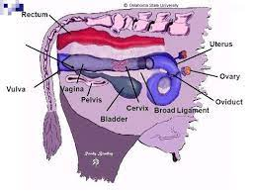

Slide 8
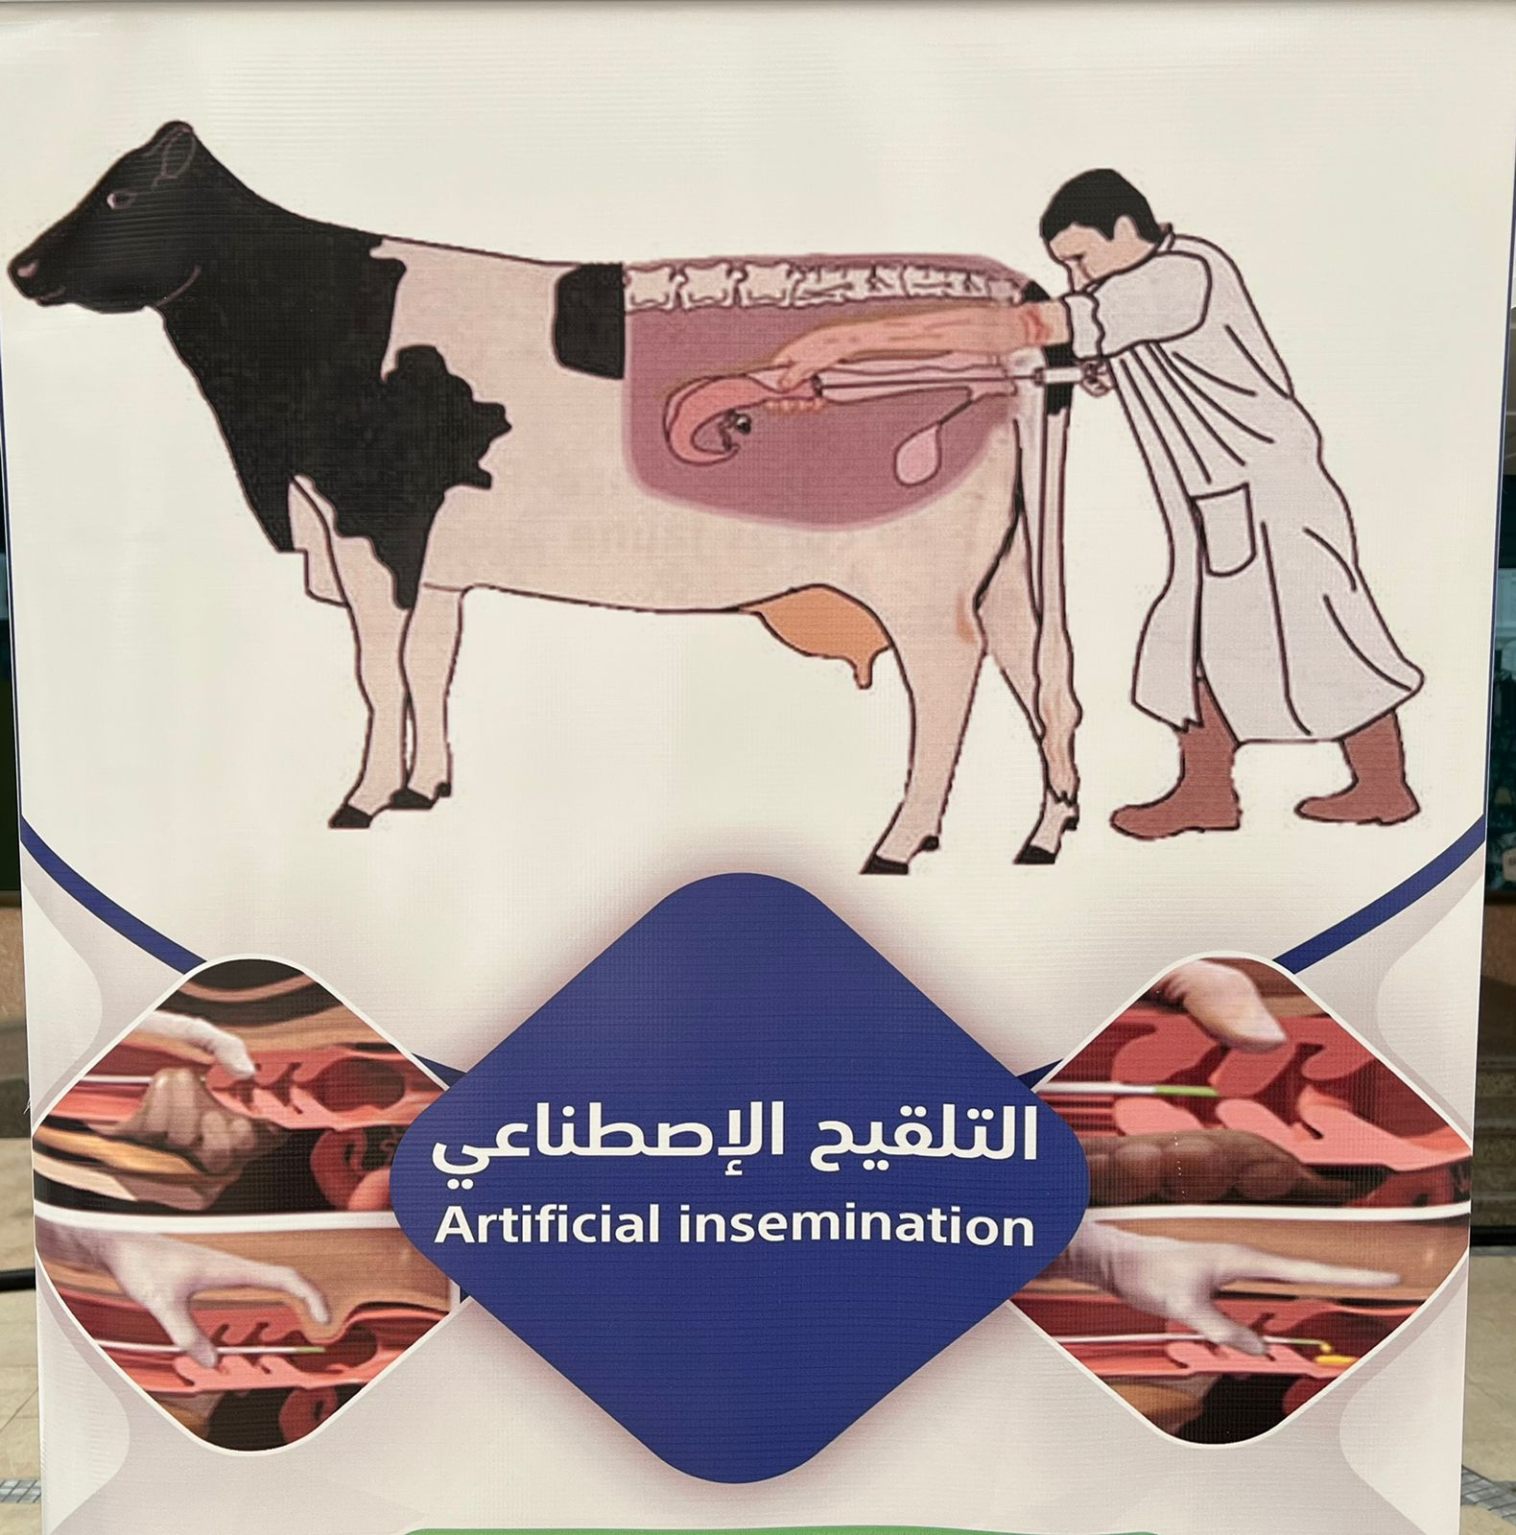

Slide 9
Objective:
To know the physiological and pathological condition of vagina. Materials Required :Vaginal speculum, liquid paraffin, soap,
water etc.
Procedure:
Restrain the cow in a crate or trevis
Clean the vulva and adjacent parts with cotton
dipped in normal saline or antiseptic solution.

Slide 10
Lubricate the sterilized vaginal speculum with liquid paraffin or soap water
.
Insert the speculum through the vulva into vagina
while keeping the jaws of speculum closed to avoid
injury.
Tum the handle of vaginal speculum either
downward or upward and open the jaws.

Slide 11
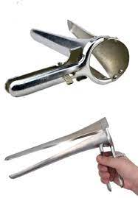
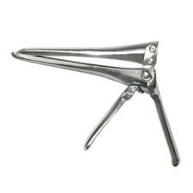
speculum

Slide 12
Use torch to observe the anterior part of vagina and outer part of cervix.
Note the finding like discharge, vaginitis, abscess,
tumour, cervix (open or closed), cervicitis etc.
Remove the speculum in an open fashion.

Slide 13
Interesting Facts
• Speculum examination is totally contra-indicated in pregnant animals and in animals suffering from severe vaginitis and other
painful conditions.
• Vaginal examination, AI or intrauterine treatment is contraindicated when the vulvar lips are wet or soiled.

Slide 14
OBSERVATIONS :
• Case No ........................... .
• Species ............................. .
• History ............................ ..
Condition of vagina
Colour of mucus membrane
Nature of discharge
Abnormal condition, if any
Cervix
• Diagnosis .......................... .
Treatment
Rx
1.
2.
3.
4.

Slide 15
